Slide 1
Three Squares and a Semicircle
From a puzzle by Catriona Shearer

Slide 2
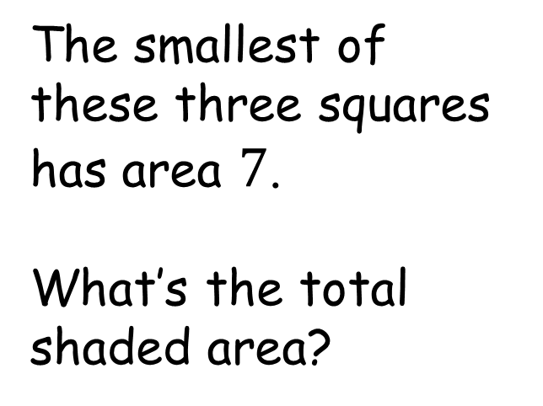

Three Squares and a Semicircle
The smallest of these three squares has area $7$.
What’s the total shaded area?
$$7$$

Slide 3





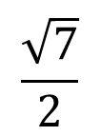


Three Squares and a Semicircle
$$L−\frac{\sqrt{7}}{2}$$
$$\frac{\sqrt{7}}{2}$$
$\left(L−\frac{\sqrt{7}}{2}\right)\frac{\sqrt{7}}{2}=\sqrt{7}×\sqrt{7}$
$L=\frac{5}{2}\sqrt{7}$
$$\sqrt{7}$$
(Intersecting chords theorem)
$$L$$
$$L−\sqrt{7}$$
$$L−\sqrt{7}$$
$$\frac{\sqrt{7}}{2}$$

Slide 4
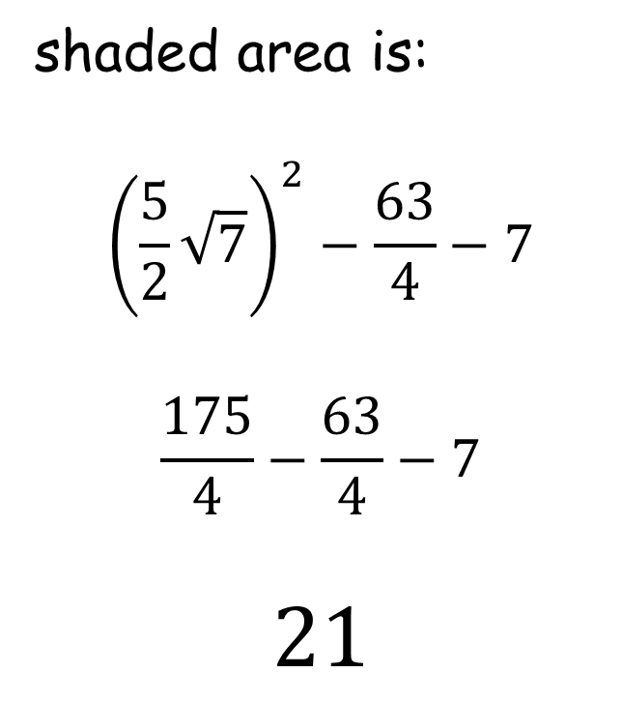

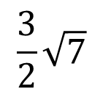
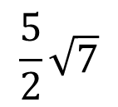
Three Squares and a Semicircle
shaded area is:
$${\left(\frac{5}{2}\sqrt{7}\right)}^{2}−\frac{63}{4}−7$$
$$\frac{175}{4}−\frac{63}{4}−7$$
$$21$$
$$7$$
$$\frac{5}{2}\sqrt{7}$$
$$\frac{63}{4}$$
$$\frac{3}{2}\sqrt{7}$$

Slide 5

Three Squares and a Semicircle
Looking at the general case…
$$A$$

Slide 6

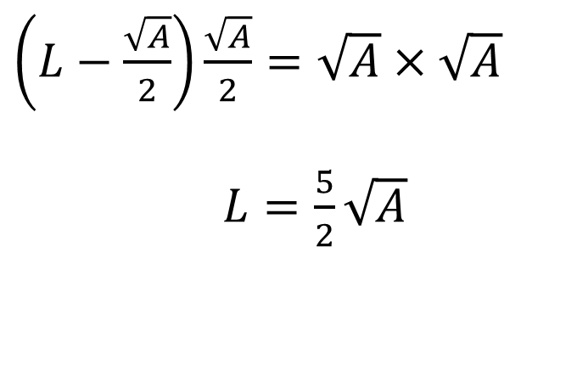


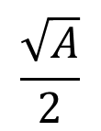


Three Squares and a Semicircle
$$L−\frac{\sqrt{A}}{2}$$
$$\frac{\sqrt{A}}{2}$$
Looking at the general case…
$\left(L−\frac{\sqrt{A}}{2}\right)\frac{\sqrt{A}}{2}=\sqrt{A}×\sqrt{A}$
$L=\frac{5}{2}\sqrt{A}$
$$\sqrt{A}$$
(Intersecting chords theorem)
$$L$$
$$L−\sqrt{A}$$
$$L−\sqrt{A}$$
$$\frac{\sqrt{A}}{2}$$

Slide 7
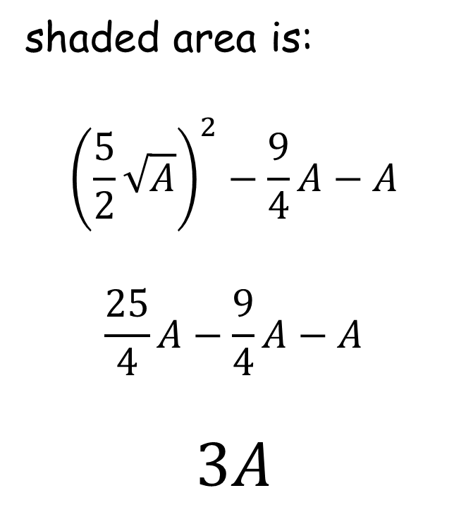

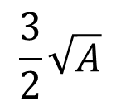
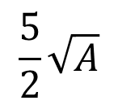
Three Squares and a Semicircle
Looking at the general case…
shaded area is:
$${\left(\frac{5}{2}\sqrt{A}\right)}^{2}−\frac{9}{4}A−A$$
$$\frac{25}{4}A−\frac{9}{4}A−A$$
$$3A$$
$$A$$
$$\frac{5}{2}\sqrt{A}$$
$$\frac{9}{4}A$$
$$\frac{3}{2}\sqrt{A}$$

Slide 8
Three Squares and a Semicircle
Another way would be…
$$A$$

Slide 9

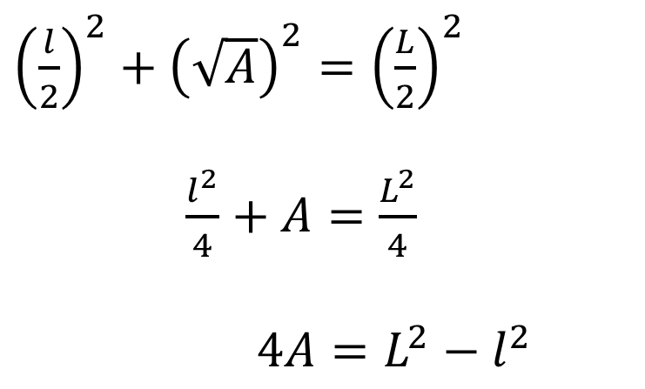



Three Squares and a Semicircle
Another way would be…
${\left(\frac{l}{2}\right)}^{2}+{\left(\sqrt{A}\right)}^{2}={\left(\frac{L}{2}\right)}^{2}$
$\frac{l^{2}}{4}+A=\frac{L^{2}}{4}$
$4A=L^{2}−l^{2}$
$$\frac{L}{2}$$
$$\sqrt{A}$$
$$L$$
$$\frac{l}{2}$$
$$l$$

Slide 10


Three Squares and a Semicircle
Another way would be…
$4A=L^{2}−l^{2}$
Shaded area is:
$$L^{2}−l^{2}−A$$
$$3A$$
$$A$$
$$L$$
$$l$$

Slide 12
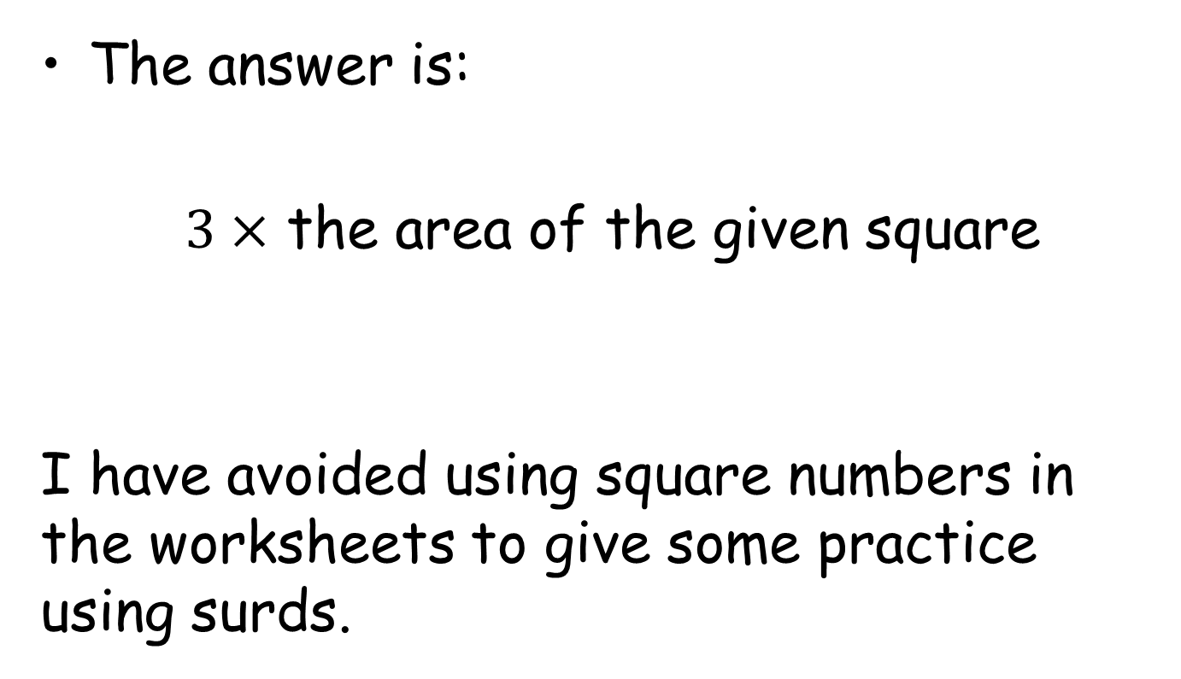
Note to Teacher
The answer is:
$3×$ the area of the given square
I have avoided using square numbers in the worksheets to give some practice using surds.

Slide 13
RESOURCES

Slide 14
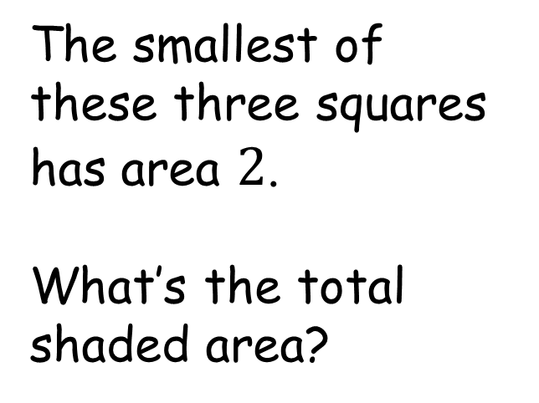

Three Squares and a Semicircle
The smallest of these three squares has area $2$.
What’s the total shaded area?
$$2$$
SIC_83

Slide 15
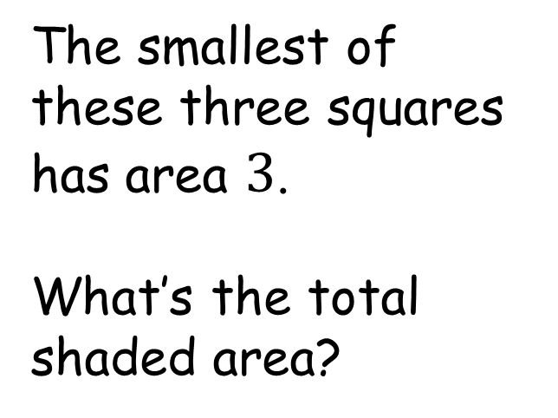

Three Squares and a Semicircle
The smallest of these three squares has area $3$.
What’s the total shaded area?
$$3$$
SIC_83

Slide 16
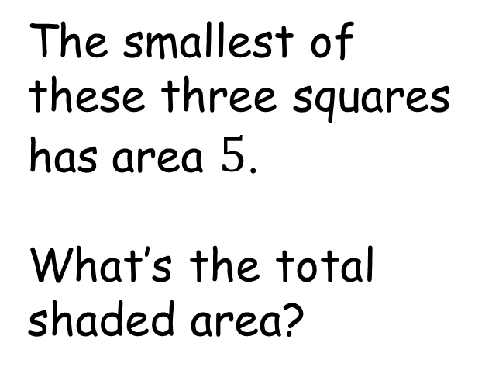

Three Squares and a Semicircle
The smallest of these three squares has area $5$.
What’s the total shaded area?
$$5$$
SIC_83

Slide 17
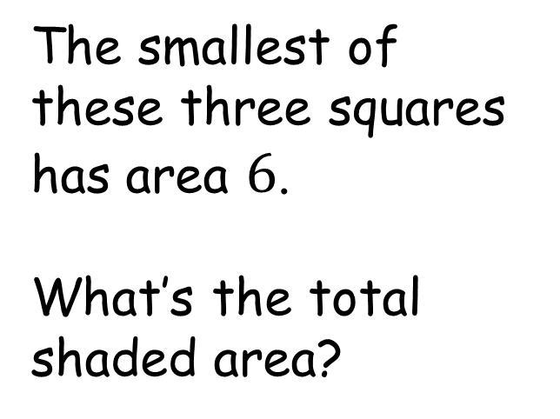

Three Squares and a Semicircle
The smallest of these three squares has area $6$.
What’s the total shaded area?
$$6$$
SIC_83

Slide 18
Three Squares and a Semicircle
The smallest of these three squares has area $7$.
What’s the total shaded area?
$$7$$
SIC_83

Slide 19
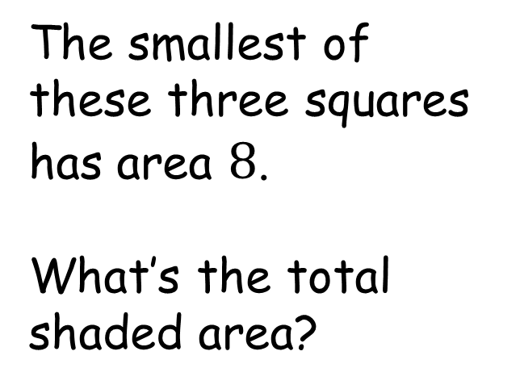

Three Squares and a Semicircle
The smallest of these three squares has area $8$.
What’s the total shaded area?
$$8$$
SIC_83

Slide 20
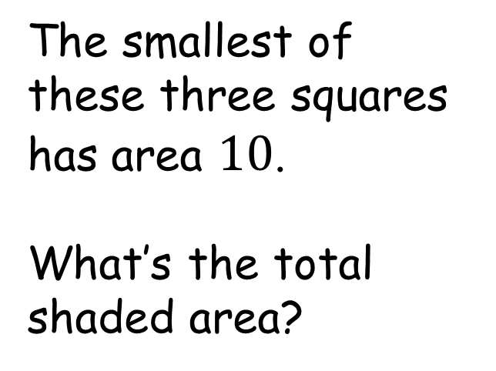

Three Squares and a Semicircle
The smallest of these three squares has area $10$.
What’s the total shaded area?
$$10$$
SIC_83

Slide 21
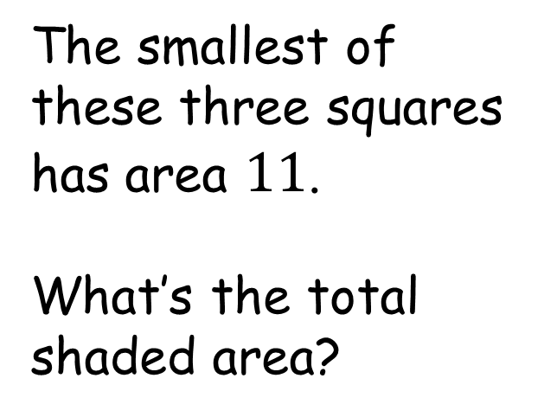

Three Squares and a Semicircle
The smallest of these three squares has area $11$.
What’s the total shaded area?
$$11$$
SIC_83

Slide 22
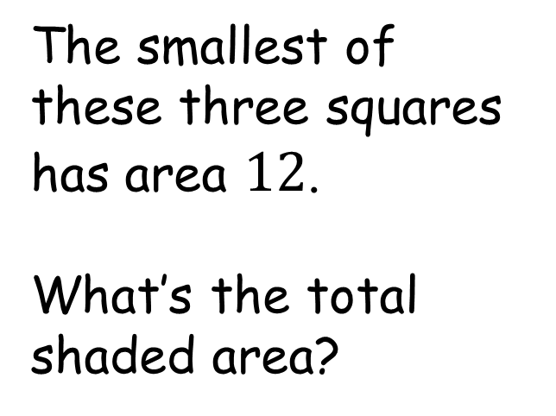

Three Squares and a Semicircle
The smallest of these three squares has area $12$.
What’s the total shaded area?
$$12$$
SIC_83

Slide 23
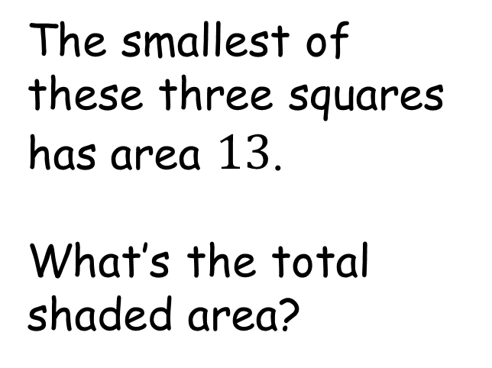

Three Squares and a Semicircle
The smallest of these three squares has area $13$.
What’s the total shaded area?
$$13$$
SIC_83

Slide 24
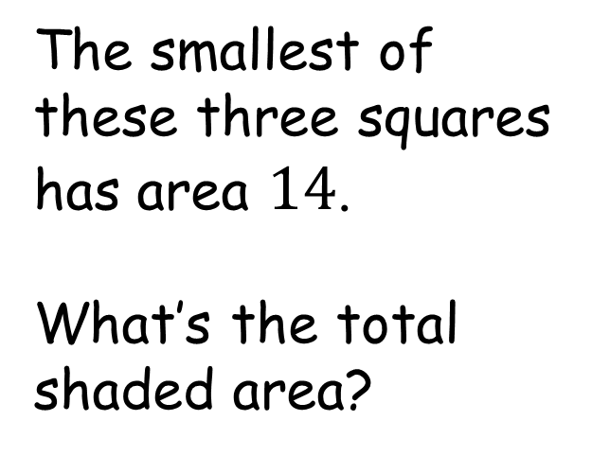

Three Squares and a Semicircle
The smallest of these three squares has area $14$.
What’s the total shaded area?
$$14$$
SIC_83

Slide 25
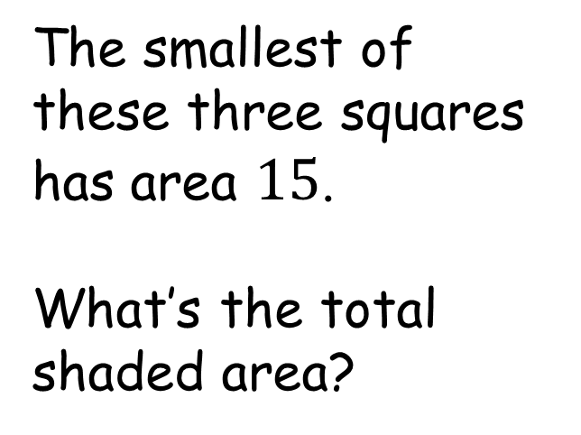

Three Squares and a Semicircle
The smallest of these three squares has area $15$.
What’s the total shaded area?
$$15$$
SIC_83

Slide 26
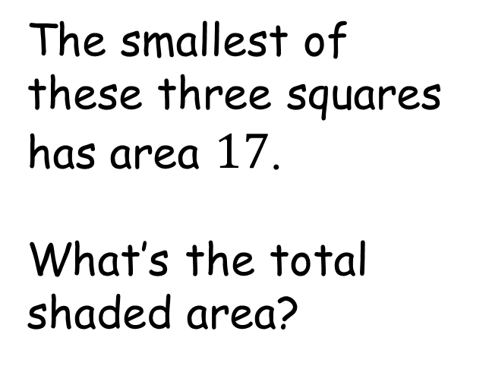

Three Squares and a Semicircle
The smallest of these three squares has area $17$.
What’s the total shaded area?
$$17$$
SIC_83

Slide 27
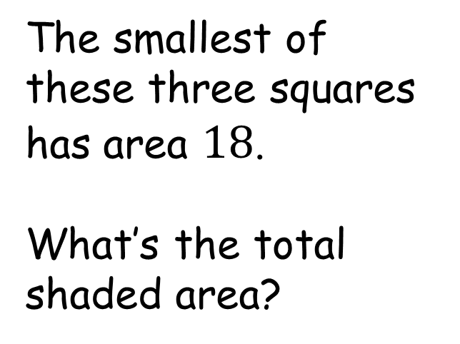

Three Squares and a Semicircle
The smallest of these three squares has area $18$.
What’s the total shaded area?
$$18$$
SIC_83

Slide 28
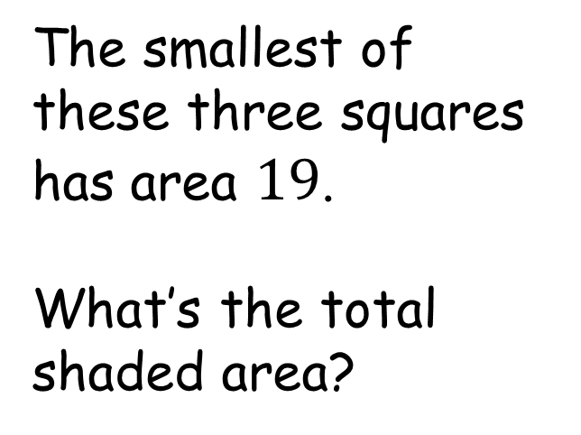

Three Squares and a Semicircle
The smallest of these three squares has area $19$.
What’s the total shaded area?
$$19$$
SIC_83

Slide 29
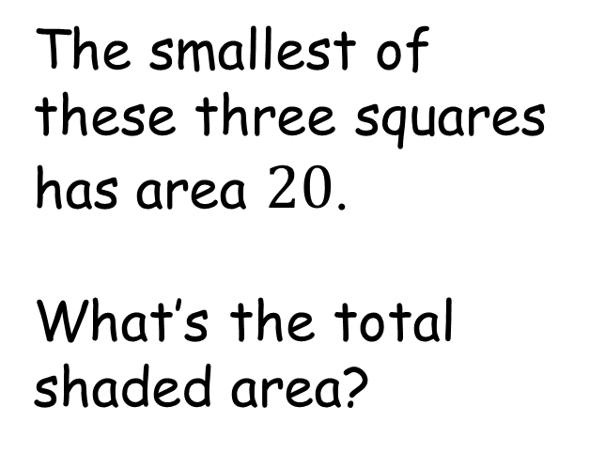

Three Squares and a Semicircle
The smallest of these three squares has area $20$.
What’s the total shaded area?
$$20$$
SIC_83

